Slide 1
Flexible Distance-Based TCR Analysis in Python with tcrdist3
Shweta Chavan 01/24/23

Slide 2
Abstract
TCRs targeting the same epitope frequently share motifs consisting of critical contact residues
Key features of tcrdist3 using examples
Example 1: integrate seq similarity networks, gene-usage plots, background-adj-cdr3 logos to identify TCR seq features conferring antigen specificity among sets of p.MHC-multimer sorted receptors
Example 2: TCR join feature to flexibly query receptor sequences of interest against bulk repertoires or libraries of previously annotated TCRs based on matching of similar sequences
Example 3: TCR dist metric can be leveraged to identify candidate polyclonal receptors under antigenic selection in bulk repertoires based on sequence neighbor enrichment testing, a statistical approach like TCRNET and ALICE algorithms, but with added flexibility in how the neighborhood can be defined.

Slide 3
TCR.dist conceptual overview
Premise: Complementarity-determining regions (CDRs) of a T cell receptor (TCR) determine its binding affinity with peptide-MHC (pMHC) complexes
Dash et al. (2017) introduced TCRdist, a weighted multi-CDR distance metric, which enabled grouping of paired αβ TCRs by antigen specificity based on their sequence similarity
Differences in the amino acid sequences of the aligned CDRs are totaled based on the number of gaps (-4) and their BLOSUM62 substitution penalties (ranging from 0 to -4) with an additional threefold weighting on CDR3 substitutions e.g. 2aa mismatch in CDR3 calls for penalty of 3*-4*2 = 4 TCRdist units (tdus)
A TCRdist can vary considerably among TCRs with identical edit distance based on the nature of the nonaligned residues
TCRdist metric can be computed between a pair of single-chain receptors or combined into a paired-chain distance

Slide 4
tcrdist3
new open-source Python software package
an interface to compute the TCRdist metric
brings new flexibility to distance-based repertoire analysis
allowing customization of the distance metric e.g Smith-Waterman alignment score, aligned Hamming distance, or edit distance
at-scale computation with sparse data representations
parallelized, byte-compiled code
can be used for pairwise distance computation between single- or paired-chain TCRs
examining TCR sequence features conferring antigen specificity
characterizing the potential specificities of an unannotated TCR repertoire with a library of previously annotated TCR sequences
with a distance-based approach, matching of TCRs can be based on sequence similarity as opposed to requiring exact sequence matching

Slide 5
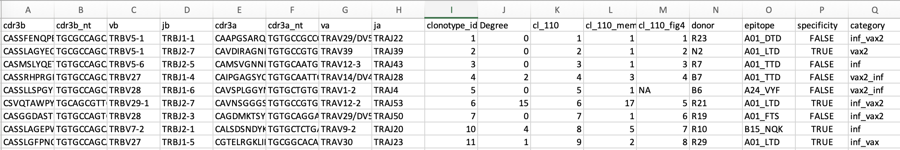
Dataset:
Paired-chain SARS-CoV-2 epitope- specific dataset by Minervina and Pogorelyy et al.
examine shared sequence features of antigen-specific TCRs
find potentially interesting clusters of similar TCRs within an unanno- tated set of repertoires from COVID-19 patients
applied directly to bulk repertoires to identify the clones most likely to be under antigenic selection
TCR chains found in 18 subjects recovered from six of the most frequently identified DNA-labeled peptide/MHC dextramers

Slide 6
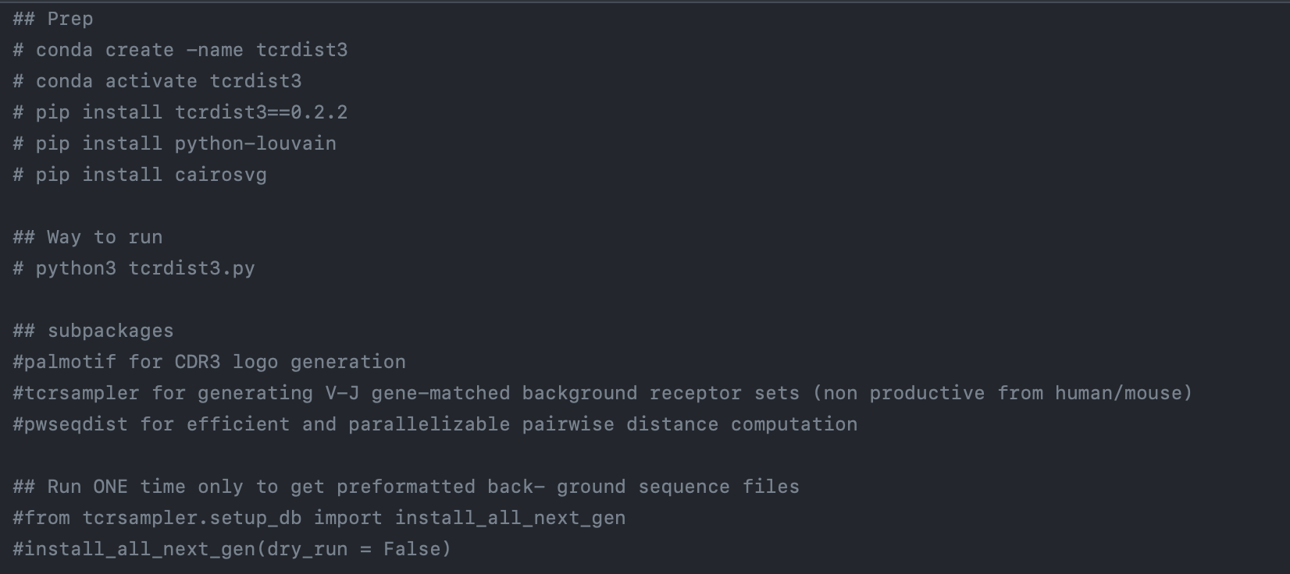
Prep & installations
https://github.com/ShwetaCh/tcrdist/blob/main/tcrdist3.py

Slide 7
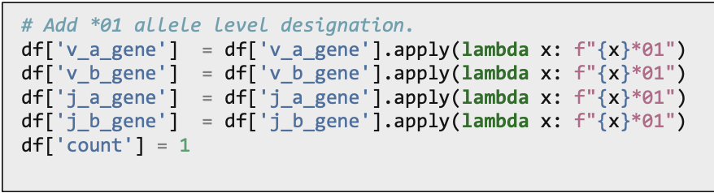
Dataset Prep
Rep-Seq data is produced using several technologies (e.g., RACE- 5, Adaptive Biotechnologies, and 10X)
gene-calling tools (e.g., MIXCR, MIGEC, ImmunoSeq, Cell Ranger)
→ to correctly identify and rename the required input columns
three input columns for single-chain analysis (i.e., for beta chain cdr3_b_aa and v_b_gene, j_b_gene)
six columns for paired-chain analysis (i.e., cdr3_b_aa, v_b_gene, j_b_gene, cdr3_a_aa, v_a_gene, and j_a_gene)
An optional count column will track the abundance of each clone. If no count column is provided, all clones are assigned a count of 1
Additional columns can be included if the user intends to distinguish input rows with donor information or epitope specificity annotations. The names of these columns are not predefined (e.g., subject, cell_type, visit, epitope).
Because tcrdist3 infers CDR1, CDR2, and CDR2.5 from the full gene and allele name, we must append an allele designation when it is unresolved in the input data. (e.g., TRBV5-1 vs TRBV5- 1*01) ← Done inside code,

Slide 8
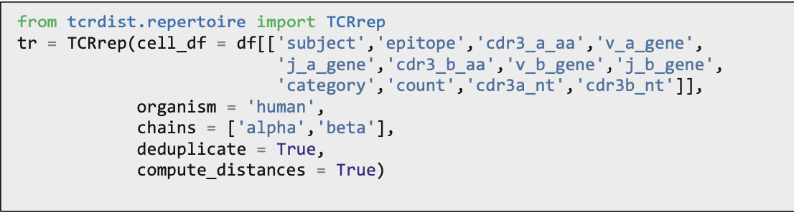
Example 1: Examining Epitope-Specific Paired αβ TCR Data
Load the data to an instance of the TCRrep class, provide organism, chains to ensure the correct lookup when appending CDR1, CDR2, and CDR2.5 sequences via IMGT nomenclature and a library of allele-specific reference genes
Any row of cell_df with an unrecog- nized V gene name will be removed from the final clone_df. Check tr.show_incomplete()
TCRrep instance contains: (i) the cell_df (ii) clone_df (deduplicated), augmented with columns containing IMGT-aligned CDR1, CDR2, and CDR2.5 inferred from the V gene nam
Computation of Pairwise Distance Matrices

Slide 9
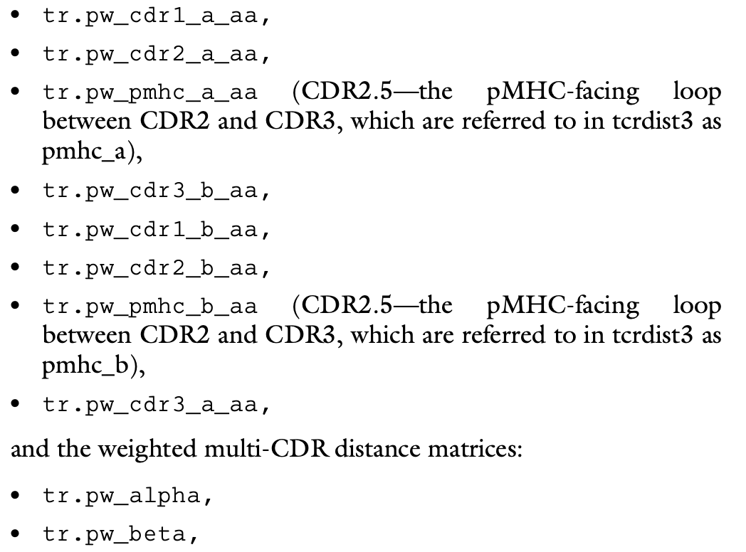
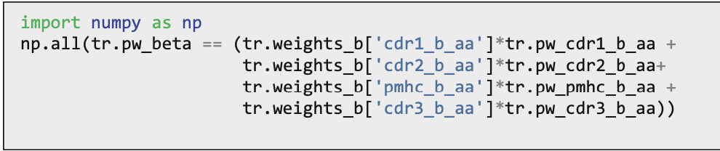
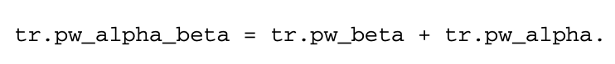
Example 1: Examining Epitope-Specific Paired αβ TCR Data (cont. 1)
Access the following pairwise distances
One can compute pairwise CDR3-only edit distance instead of multi-CDR TCRdist.

Slide 10
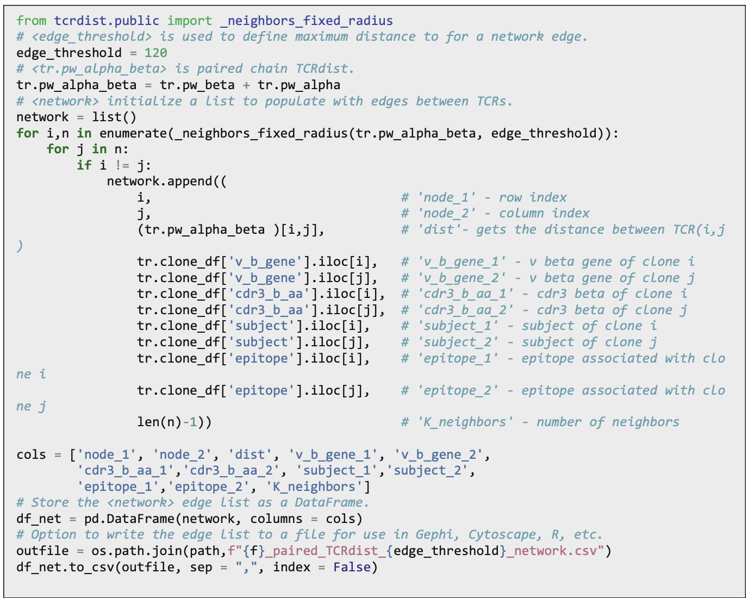
Example 1: Examining Epitope-Specific Paired αβ TCR Data (cont. 2)
Distance Matrices to Networks
construct a weighted network with edges connecting similar TCRs from these pairwise distance matrices
threshold at which to construct edges between clones is flexible
for paired-chain TCRdist with the default threefold CDR3 weight (Minervina and Pogorelyy et al selected a threshold of 120 TCRdist)

Slide 11
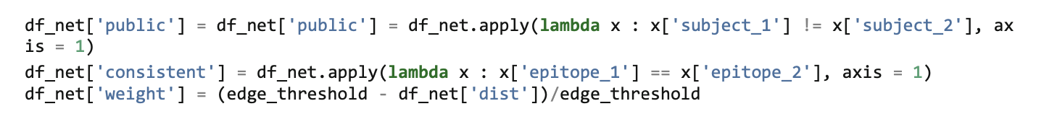
Example 1: Examining Epitope-Specific Paired αβ TCR Data (cont. 3) Nuances – Example 1
all the network edges are represented as unique rows in the df_net, we can add columns to designate edges that unite nodes that come from different donors (i.e., public)
One can identify edges that link TCRs recognizing the same epitope (i.e., consistent edges). Large fraction of inconsistent edges may indicate an overly permissive edge threshold
One can assign a weight proportional to similarity by subtracting the pairwise distance from the max edge threshold distance and dividing by the edge threshold. This will result in more similar TCRs having higher-edge weights, with weights bound between 1 and 0.

Slide 12
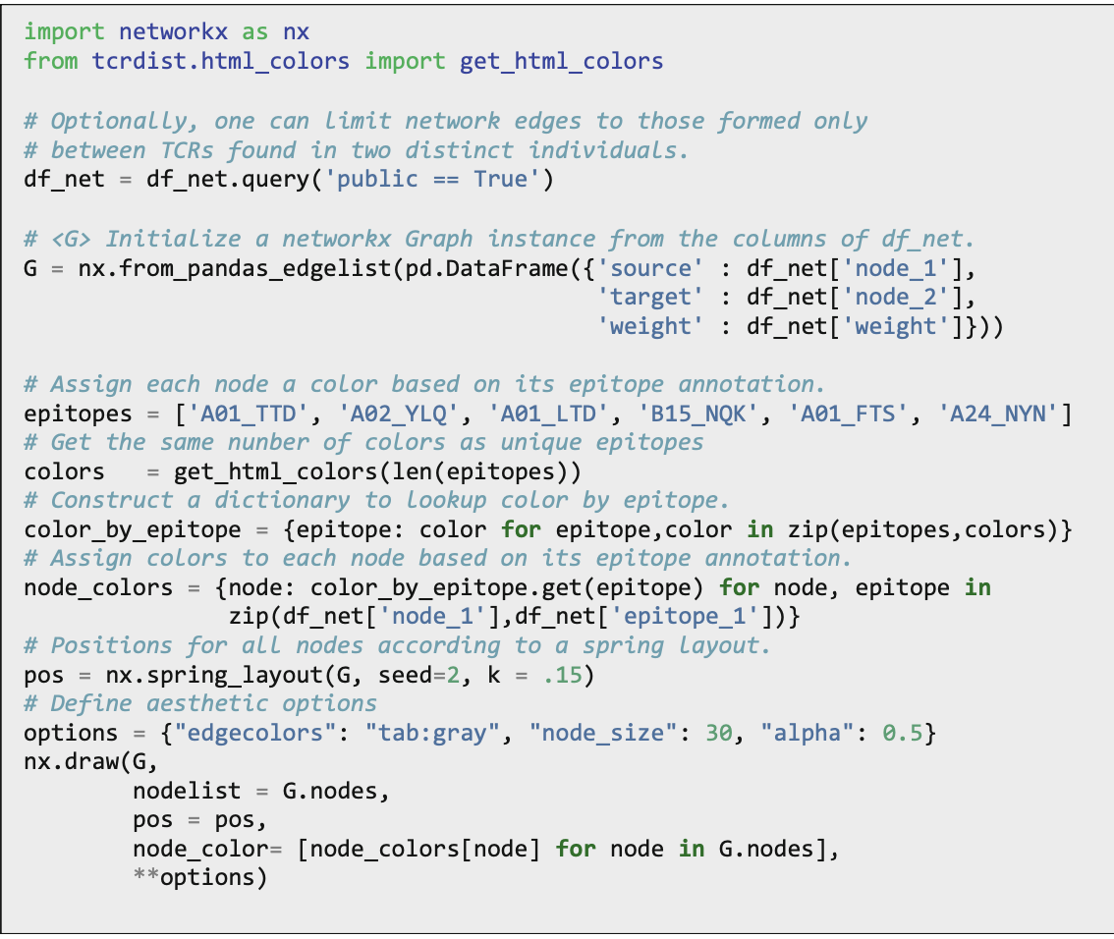
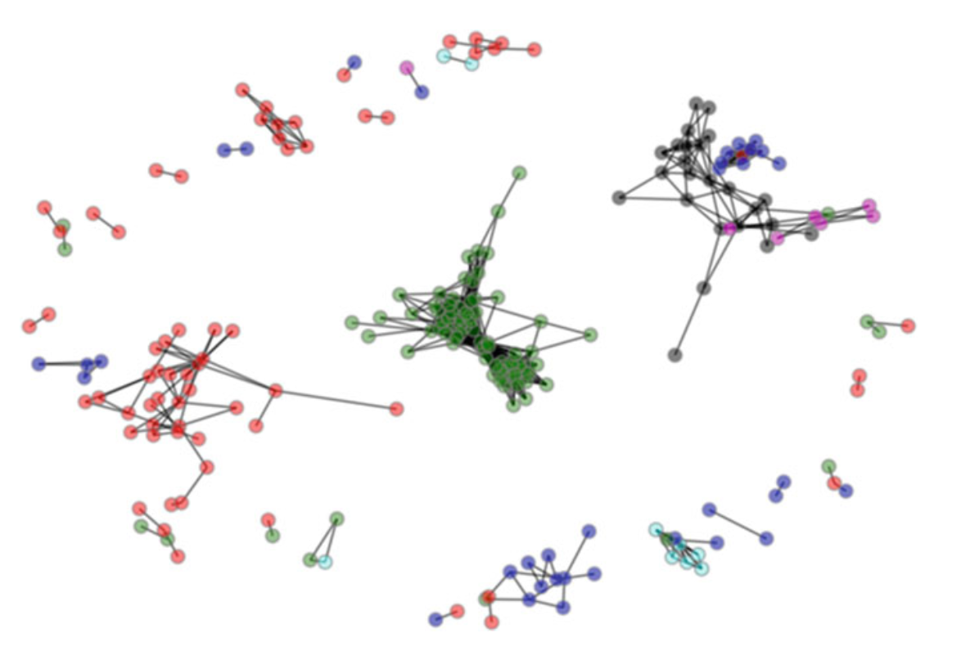
Example 1: Examining Epitope-Specific Paired αβ TCR Data (cont. 4)
Visualization of TCRdist Networks
Network formed by epitope-specific TCRs.
Edge threshold = 120 TCR distance units.
TCRs = six immunodominant SARS-CoV-2 epitopes identified in Minervina and Pogorelyy et al. 1 color = 1 epitope
Network edges = those formed between TCRs in different participants, emphasizing the public nature of the sequence similarity
Biochemically similar TCRs often recognize the same epitope
Notes:
If they are public, we see lots of edges!

Slide 13
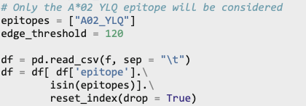
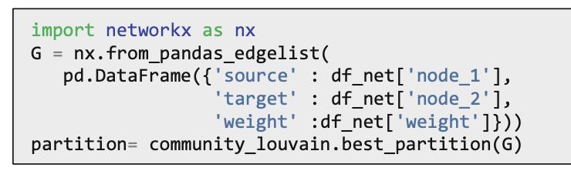
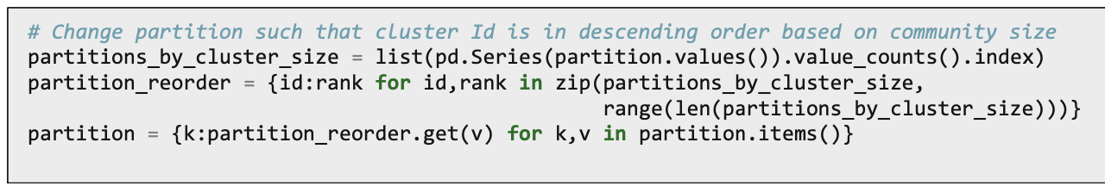
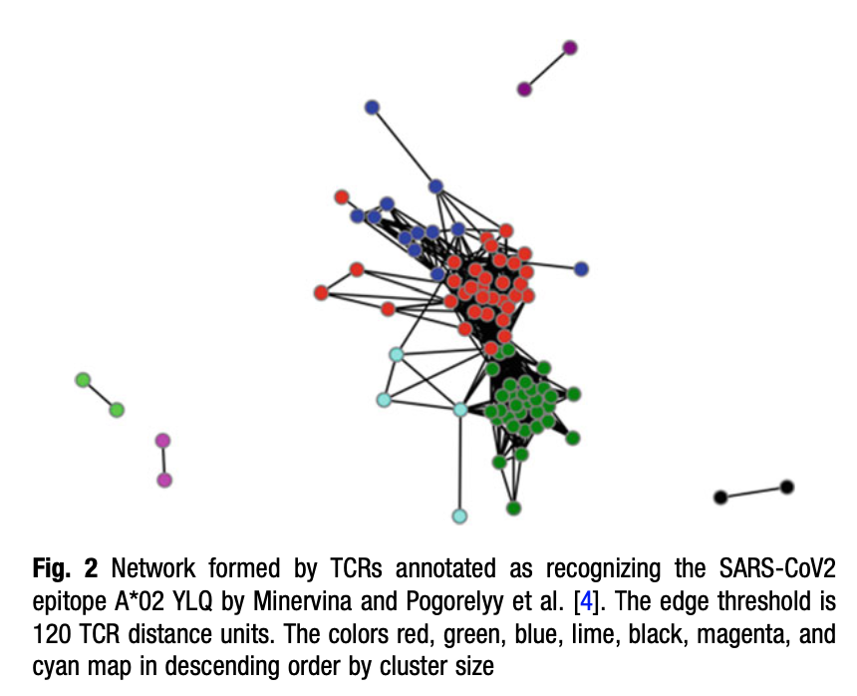
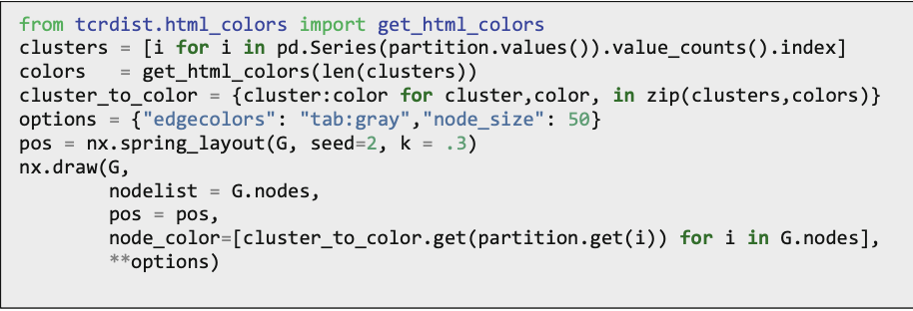
Networks Among A*02 YLQ-Annotated TCRs
Closely examine clusters of TCRs annotated to bind the A*02 YLQPRTFLL pMHC multimer (green)
Apply the Louvain community identification algorithm to identify grouping of highly networked TCRs within the set of A*02 YLQ-specific TCRs
Reassign cluster numbers such that 0 corresponds with the largest cluster, 1 with the second largest cluster, and so on.

Slide 14
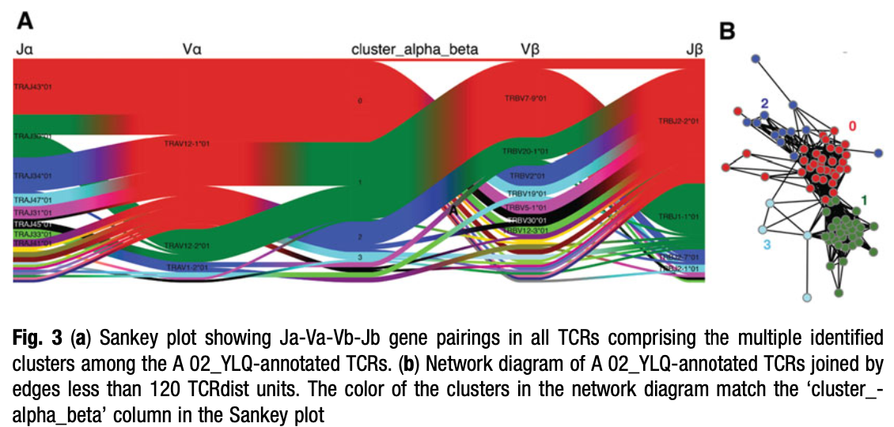
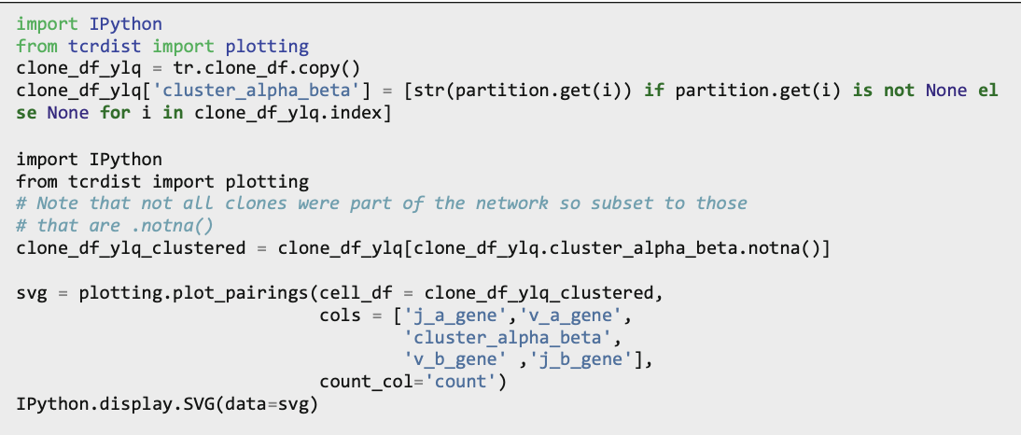
A*02 YLQ Cluster Gene Usage: frequency of gene usage and gene pairings
identify different Va, Ja, Vb, and Jb gene pairings within any user-specified TCR set.
the largest cluster (red) is defined by the exclusive use of TRAV12-1 with TRAJ43 or TRAJ30 genes
TRAV12-1 alpha chains within this cluster pair with beta chains formed from VDJ junctions involving many possible TRBV genes (including TRBV2, TRBV19, TRBV30, TRBV5-1, TRBV12-3, and others)
By contrast, the second most abundant cluster (green) is comprised of TCRs nearly exclusively formed from TRBV7-9/TRBJ1-1 beta- recombination, with an alpha chain using either TRAV12-2 or TRAV12-1.
Observable gene-usage pattern is potential evidence that the modes of binding achieved by TCRs in these two common clusters likely differ

Slide 15
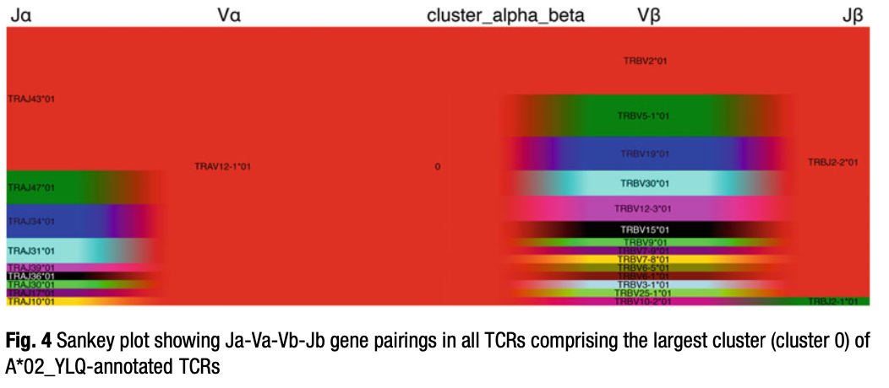
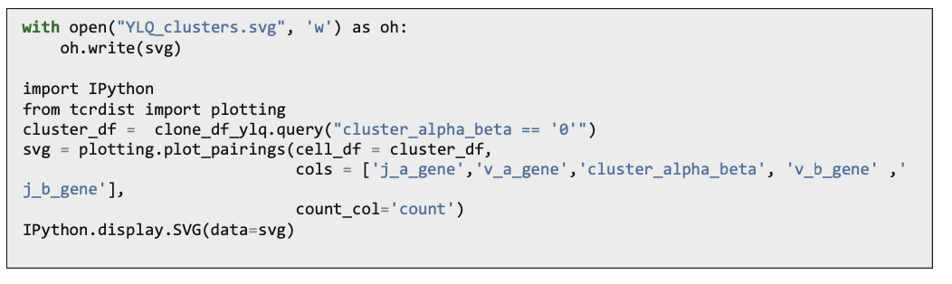
See each cluster’s gene usage in isolation

Slide 16
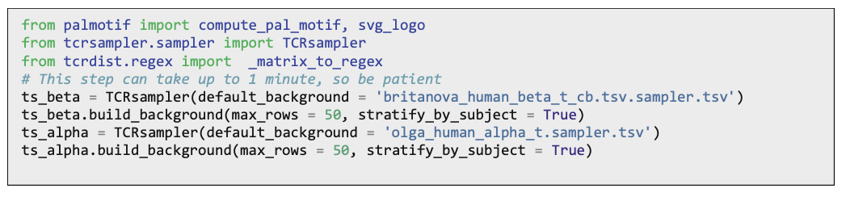
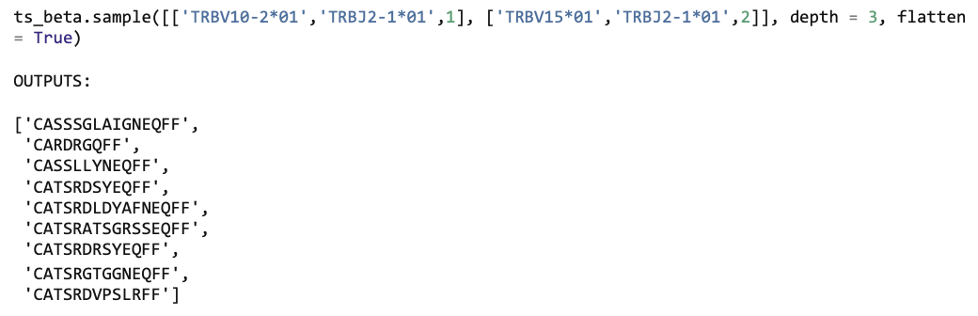
Background- Subtracted CDR3 Logos : TCRsampler
Through the process of VDJ recombination, CDR3s contain germline-encoded as well as randomly generated amino acids.
Since germline-encoded residues are common (in each individual), non-distinct features of TCRs, it is the non-germline residues which often define a receptor’s antigen specificity.
To visually identify those portions of the motif that are unexpected beyond residues contributed by germline V and J gene segments, tcrdist3 allows users to generate “background-subtracted” logos
TCRsampler facilitates rapid generation of a background set of TCRs that share the same V and J gene usage as a foreground set of TCRs to facilitate their comparison.
beta chain and will use cord blood from eight donors
alpha chain, we will use precomputed synthetic TCRs generated with the software OLGA from a generation probability model trained on nonproductive TCRs
TCRsampler.sample returns a set of x random CDR3s with the same gene usage. In practice, a larger background with many V- and J-matched random CDR3 sequences is required.

Slide 17
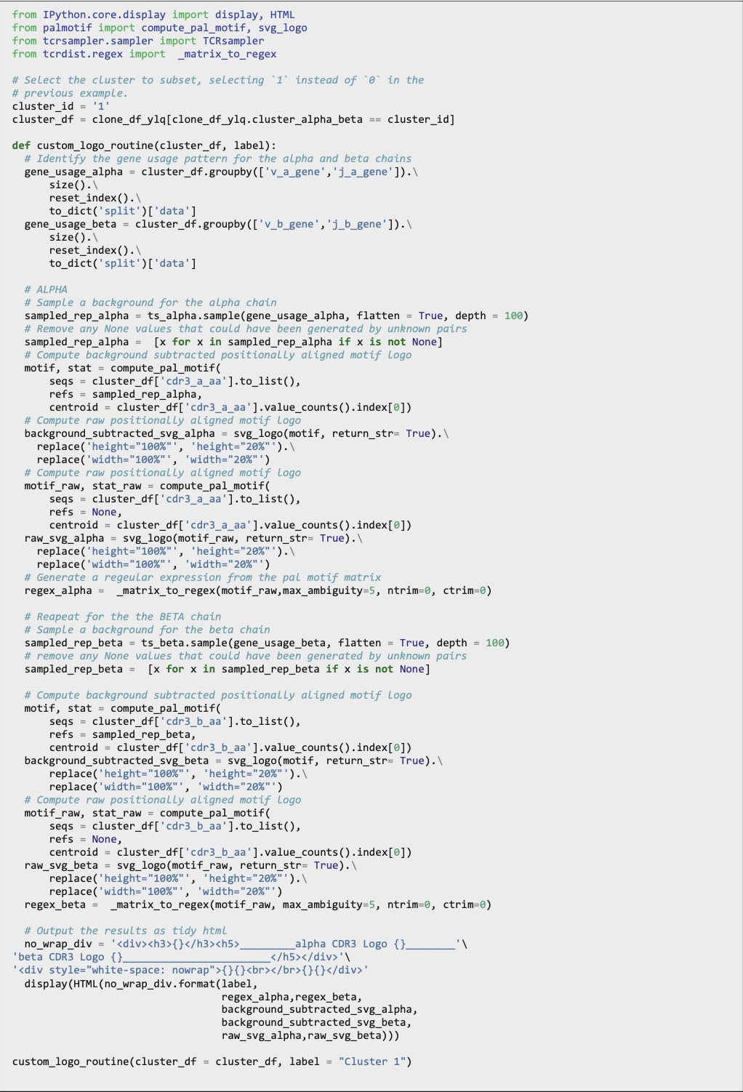
Deeper background for a specific cluster
Filter the cluster to retain only those clones
Format the gene-usage information in the form that TCRsampler recognizes (i.e., a list of lists each with three parts specifying the (i) V gene, (ii) J gene, and (iii) count).
Use the gene-usage objects to generate backgrounds of CDR3s for both the alpha and beta chain.

Slide 18
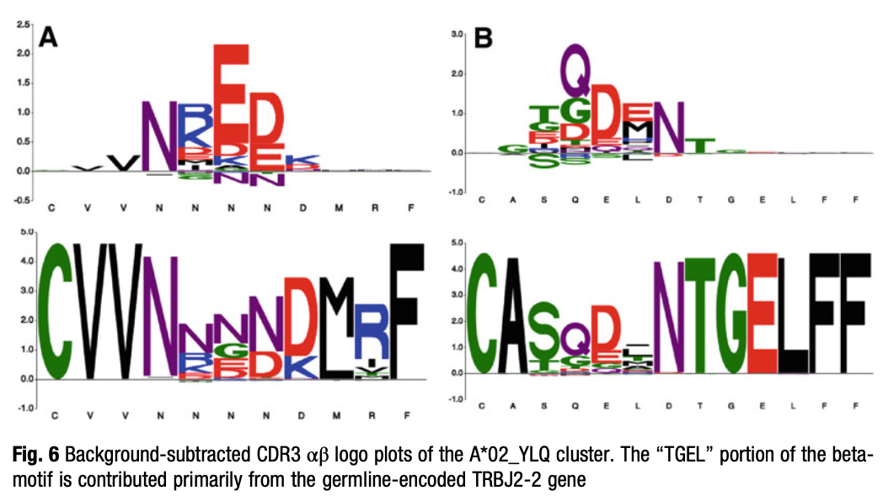
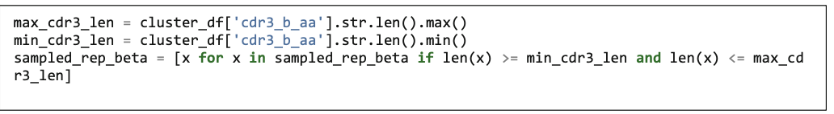
SVG CDR3 αβ Logos
compute_- pal_motif and svg_logo functions in the palmotif package
By aligning both foreground and background CDR3s to a centroid sequence, we have a simple global alignment that can be used to identify the distinctive residues of an antigen-specific TCR set.
background-adjusted emphasizes the uncommon amino acid residues
all TCR CDR3 amino acid sequences – raw logo
tcrdist3 permits the user flexibility to provide any set of background CDRs to the refs argument that might be most appropriate. For instance, a tissue- specific, HLA-matched, or strain-specific background could be used
Positionally Aligned Motif Logos: construct a background by selecting only those CDR3s of the same length ranges as the foreground receptor pool being evaluated

Slide 19
Example 2: Finding Biochemically Similar TCRs in a Larger Set of Unannotated TCRs

Slide 20
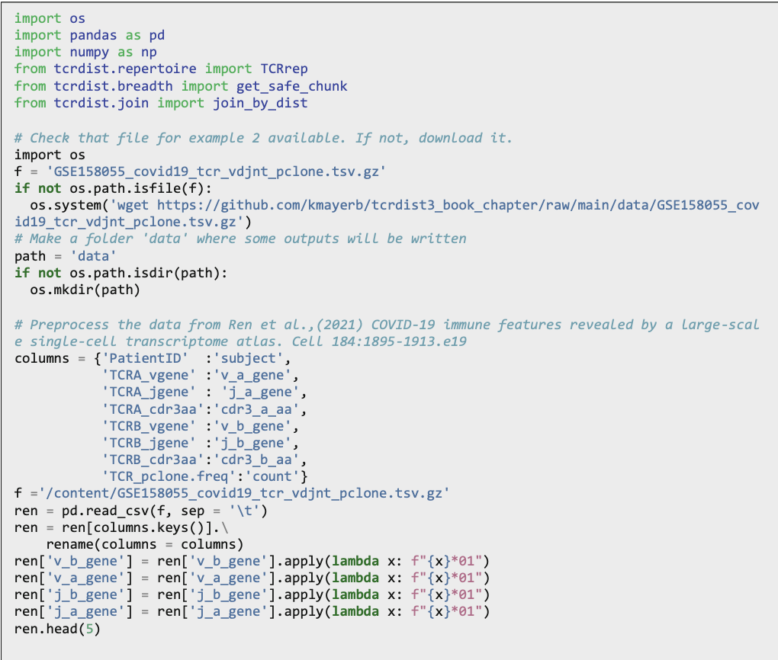
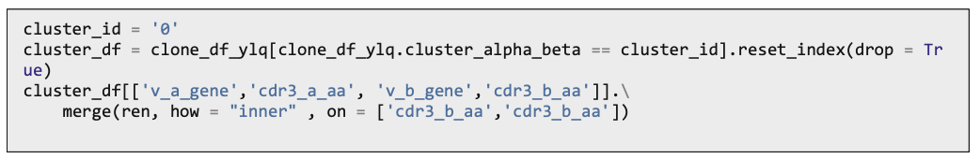
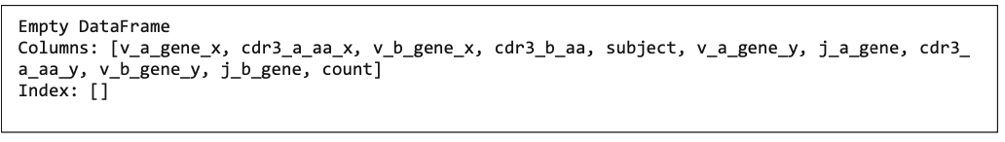
Use case
Q: Whether the TCRs found in cluster 0 (A*02:01:YLQ) are commonly detectable in unenriched repertoires from COVID-19 patients in the context of natural infection
A:
Dataset: published single-cell TCR data generated from COVID-19 patient samples by Ren et al
Check for identical CDR3 alpha and CDR3 beta amino acid sequences in “cluster 0” TCRs annotated as A*02 YLQ-specific using merge function

Slide 21
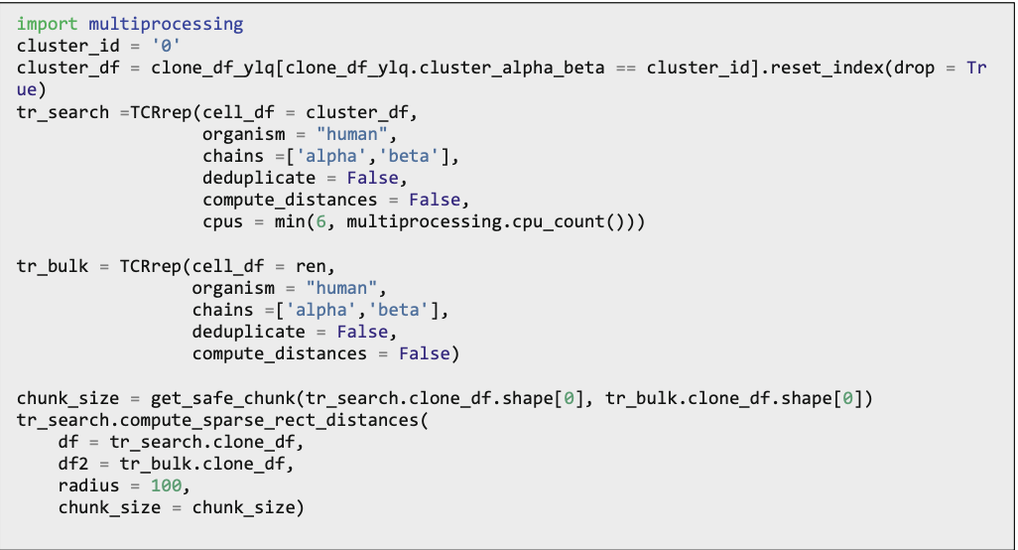
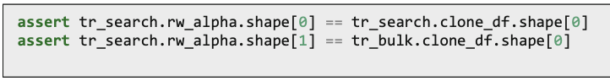
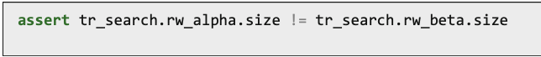
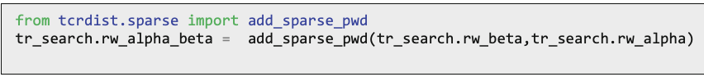
Use case(contd)
Check for similar, nonidentical TCRs : Use “rectangular” instead of “square” pairwise (all vs. all) distances i.e. compute distances between TCRs in one, often small, “search” set against a second, often much larger, “bulk” set of TCRs.
scipy sparse.csrmat for applying user threshold
Returns
tr_search.rw_beta
tr_search.rw_alpha
Check if dim are as expected
if we wish to get combined alpha-beta TCRdist from sparse csr matrices, the number of entries stored in each should be identical, if they’re not:
we need to use the function tcrdist.sparse. add_sparse_pwd so that only those {i, j} coordinates with entries in both sparse matrices will be present in the resulting matrix.

Slide 22
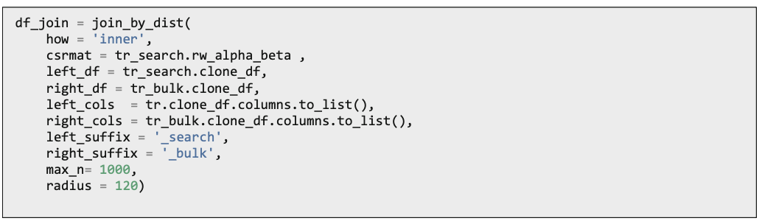
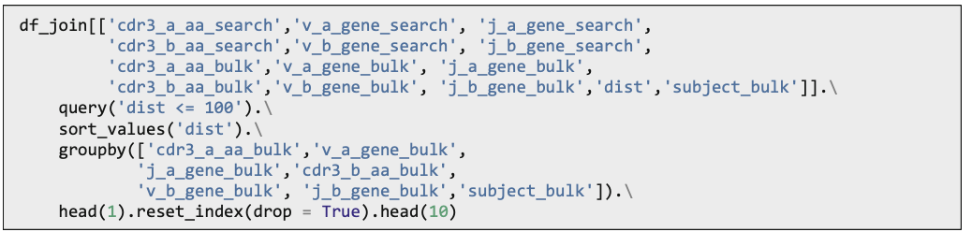
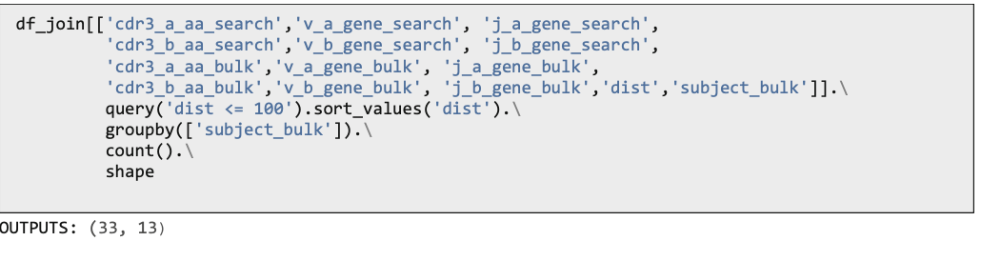
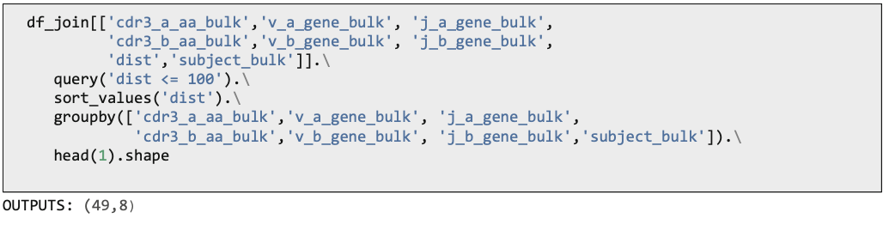
Use case(cont.d)
tcrdist.join.join_by_dist performs a database-style join;
it joins rows with TCRs that share a pairwise distance less than the threshold specified by the radius argument.
For each TCR in the “left” DataFrame, the function returns up to max_n nearest neighbors in the right DataFrame.
View the closest nonidentical matches, there are 49 clones (in 33 of 136 unique subjects) within 100 TCRdistance units from a TCR in cluster 0.
Grouping by subject, we see approximately 33 subjects have a TCR within 100 TCR distance units from one of the annotated A*02 YLQ TCRs cluster 0 sequences.
Grouping by subject, V genes, J genes, and CDR3s, we see approximately 50 subject-unique TCRs were within 100 TCRdis- tance units from one of the annotated A*02 YLQ TCRs cluster 0 sequences.

Slide 23
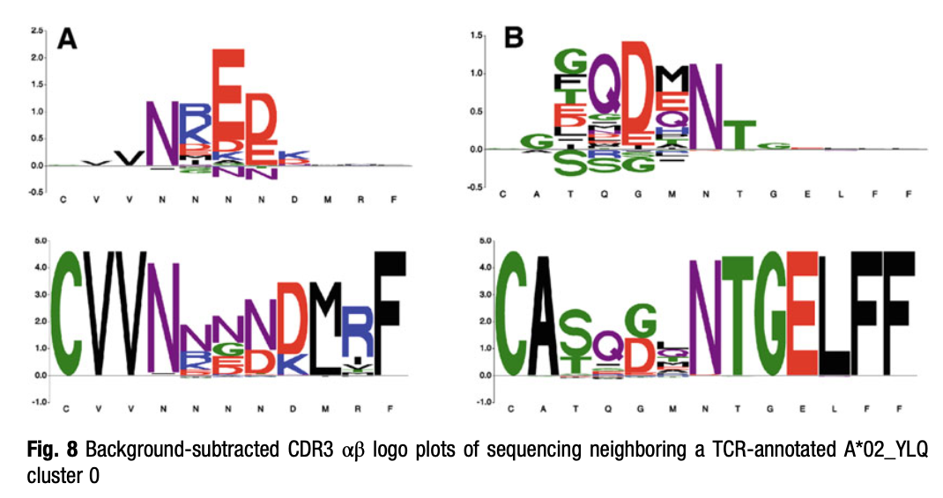
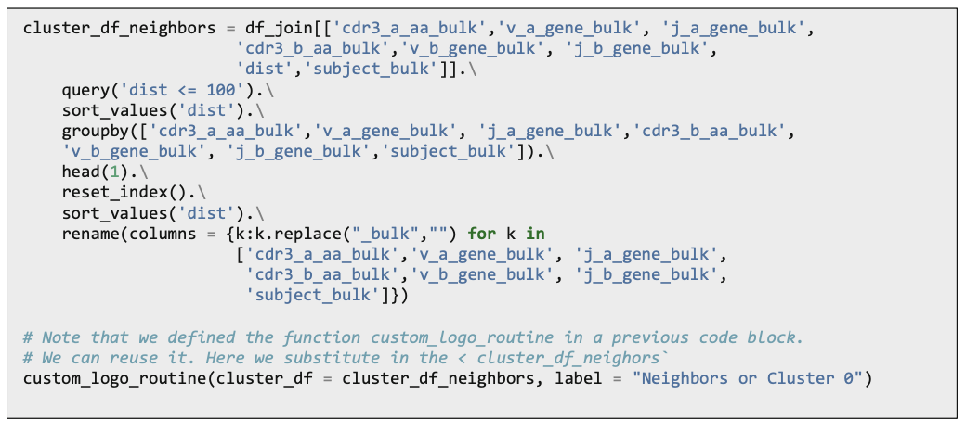
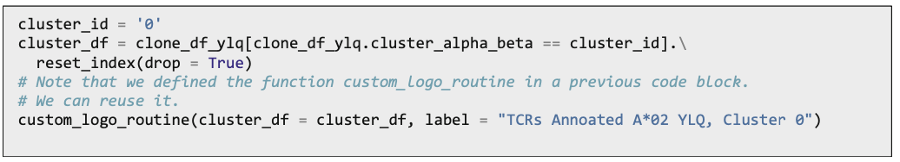
CDR3 Logo Motifs from Neighboring Sequences
Compare this logo with the original logo
Note the conservation in the key residues of the alpha chain.

Slide 24
3.3 Example 3: Comprehensive Analysis of Bulk Unannotated Data

Slide 25
Identifying important clones within bulk deeply sequenced TCR repertoires
Algorithms such as TCRNET and ALICE have been proposed to identify TCRs sharing antigen specificity within bulk repertoires when no in vitro binding or activation data is present.
These identify TCR nodes in a network with an enriched number of edges compared to the expected number of edges in an antigen- naıve repertoire estimated from a background (TCRNET) or derived from a probability model (ALICE)
GLIPH & GLIPH2 allow users to analyze bulk repertoires for groups of TCRs with shared CDR3 k-mer motifs that are more frequent within the repertoire than in a background of a naive reference TCR set.
GIANA proposed a novel embedding that enables approximate nearest neighbor identification of TCRs, enabling a two-phase approach, limiting the number of total pair- wise alignments required in the second step.
tcrdist3, it is also computationally feasible to evaluate all-vs-all TCRs, must be run with the sparse data storage option that retains only the subset of pairwise distances beneath a desired threshold. [50,000 to 200,000 unique clones 6-CPU, 16-GB]
For following examples, at least 12 CPUS and 64 GB of memory.

Slide 26
Method
ImmuneRACE effort data - bulk PBMC repertoire from a convalescent COVID-19 patient.
download precomputed distance matrices, <72 units stored in sparse format
Since it’s single-chain data, we opted to use a 6x weighing on the CDR3 and relatively wide search radius
Finding neighboring TCRS as either (i) TCRs with identical V-gene-encoded CDRs and CDR3s with 0–3 substitutions or (ii) TCRs with slightly different V gene-encoded CDRs and CDR3s with 0–1 substitutions.
Based on the assumption that antigen exposure increases the detection probability of clones, we examine which clones have close neighbors within the repertoire.
Consider close neighbors for the purposes of statistical testing → only those within 48 TCR distance units (6:1:1:1 CDR3 weighted), accommodating (i) up to two major substitutions or gaps in the CDR3 or identical CDR3 with (ii) slightly differing v-gene-encoded CDR
At TCRdist 48 (6:1:1:1 CDR3 weighted), there are 6408 clones with five or more neighbors.
Load 960,000 sequences from eight cord blood sam- ples to estimate the neighbor frequency of neighbors in an antigen- na ̈ıve background
Formulate a model for a null expectation based on the Poisson distribution, where d is the expected number of neighbors, get an FDR

Slide 27
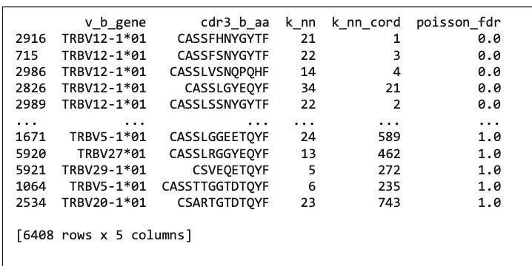
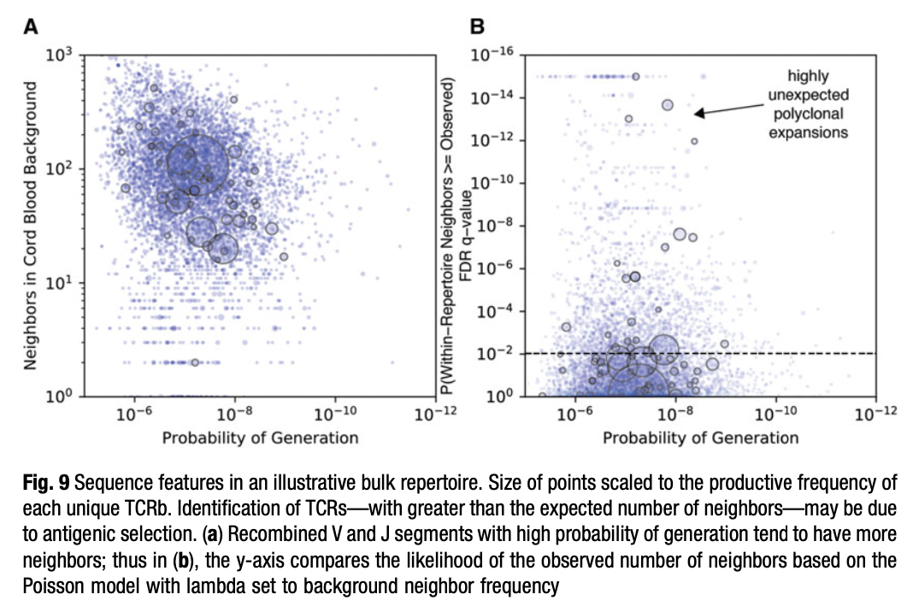
Results sorted by lowest FDR.adj p-value
For example, clone 2916 has 21 nearest neighbors within its repertoire, within the relatively conservative threshold of 72 tdus. Only one neighbor was identified in the background cord blood repertoires.
9. Estimate the probability of generation for each CDR3 using OLGA. Compute Pgen estimates for each of the 6408 clones with four or more neighbors in the bulk repertoire
The size of each circle is scaled to each clone’s productive frequency, so that large circles emphasize the expanded clones in this beta-chain receptor set.
Shows correlation between (Pgen) and the #neighbors to each TCR in the cord blood background → higher Pgen CDR3s tend to have more neighbors because they are closer to germline-encoded sequences. These receptors are more common and public due to shared molecular recombination biases
By contrast, the low Pgen receptors (at the bottom right of Fig. 9a) tend to be longer with a greater number of randomly inserted nucleotides within the V(D)J junction. They have few neighbors in the cord blood background.

Slide 28
Takeaway
The number of total neighbors a clone has is not, on its own, a reliable metric to differentiate TCRs that may or may not be under antigen selection.
Hence, we consider the conditional likelihood (unexpectedness) that the number of neighbors is greater than the expected number of neighbors, based on the frequency of neighbors in a relevant antigen-na ̈ıve background.
Figure 9b shows the probability of generation of each clone on the x-axis and the unexpectedness of the within- repertoire neighbor count on the y-axis.
Clones of interest are the unexpected clones: those with a higher-than-expected number of neighbors.
Plotting the data in this way allows for identification of low-Pgen, unexpected, and expanded clones
Many of the clones that manifest evidence of antigenic selection may be due to exposure to common human pathogens, such as CMV, EBV, or influenza. Thus, to the extent possible, one might want to exclude clones with a higher-than-expected number of neighbors if they closely resemble TCRs with existing annotations to recognize these common viral epitopes.

Slide 29
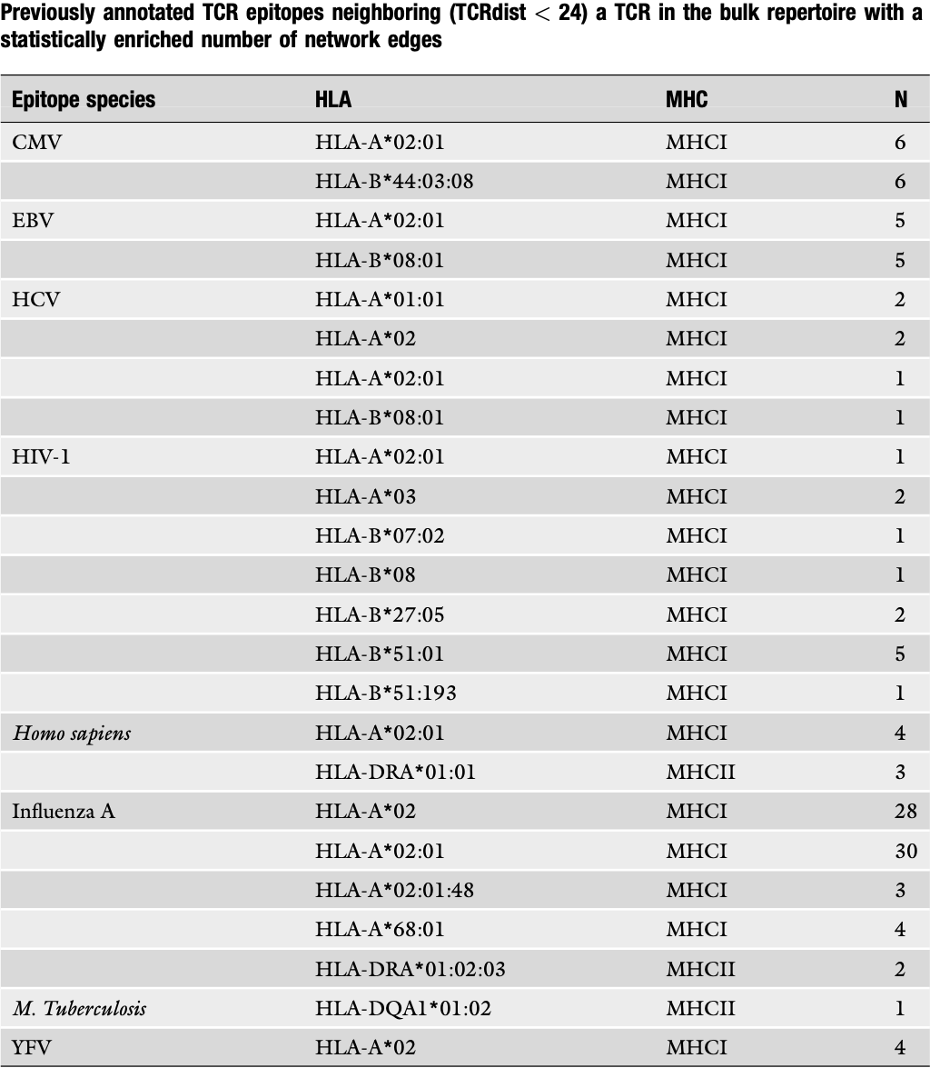
Table of TCRs with epitope annotations from VDJdb
Compute the distance between clones in the bulk repertoire with four or more neighbors and all of the TCRs in the VDJdb table with quality score >0
Join bulk rep with vdjdb -- join-by-distance
Within the set of TCRs that have a statistically anomalous number of neighbors, we find that 47 of the TCRs have at least one prior annotation in VDJdb (among annotations with quality score >0) within 24 TCRdistance units.
One could remove only those TCRs with an pMHC annotation matching one or more allele in the donor’s genotype or be more conservative and exclude any TCR highly similar to an already annotated TCR.
2000 remaining TCRs, which, based on neighbor enrichment sta- tistics, could represent TCRs under antigenic selection following the patient’s SARS-CoV-2 infection

Slide 30
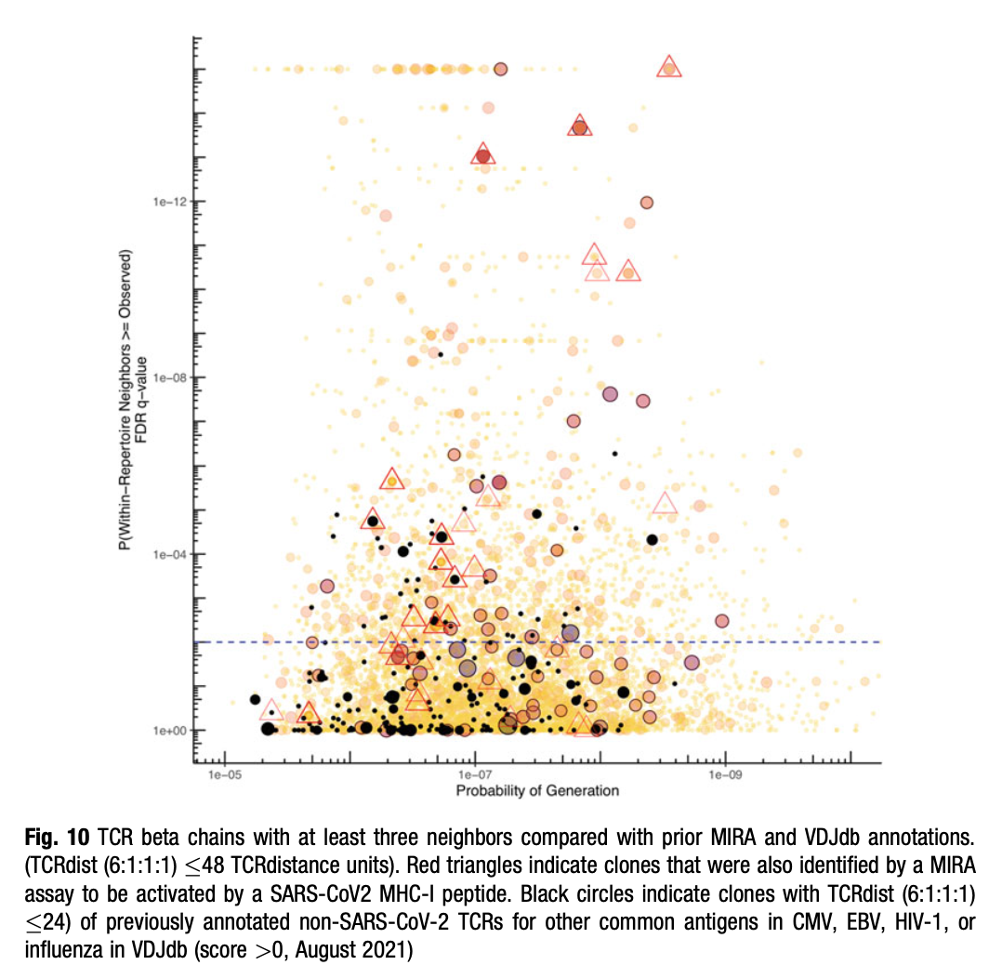
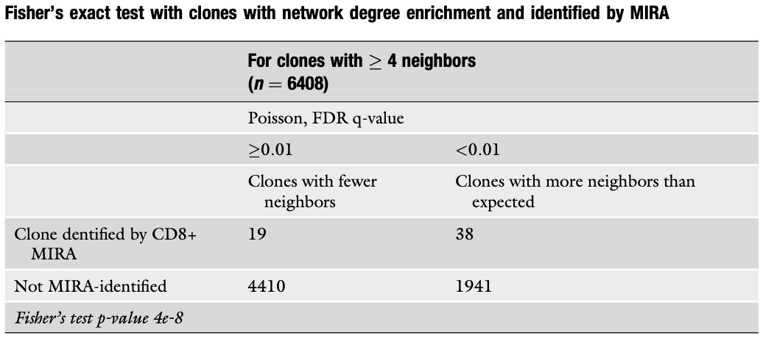
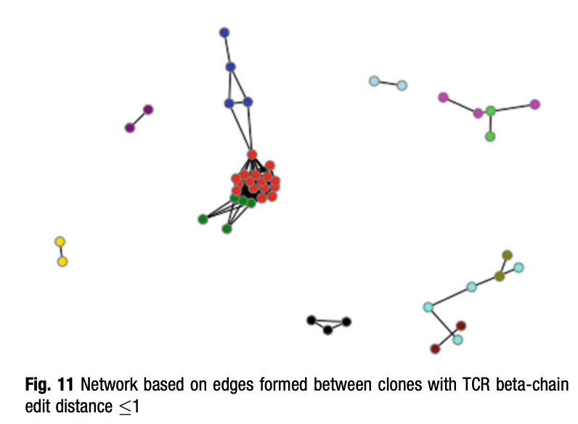
MIRA-Matched Clones
donor also contributed samples for a multiplex identification of an antigen-specific T cell receptor assay (MIRA) experiment
MIRA matched ['v_b_gene','j_b_gene','cdr3_b_aa’] clones: multiplex identification of an antigen-specific T cell receptor assay (MIRA) experiment - in vitro CD8 activation marker assays - with > 4 within repertoire neighbors
The presence of SARS-CoV-2 MIRA-matched clones that also have higher than expected neighbor frequency suggests that statis- tical degree enrichment methods such as ALICE, TCRNET, and the method above using TCRdist can be useful for identifying clones that are under antigenic selection from a recent natural infection.

Slide 31
What we liked
Allowing change of distance metrics
Multi-CDR metrics
Scalable
What we don’t like
It’s not in R!!!
Installation heavy

